Slide 2
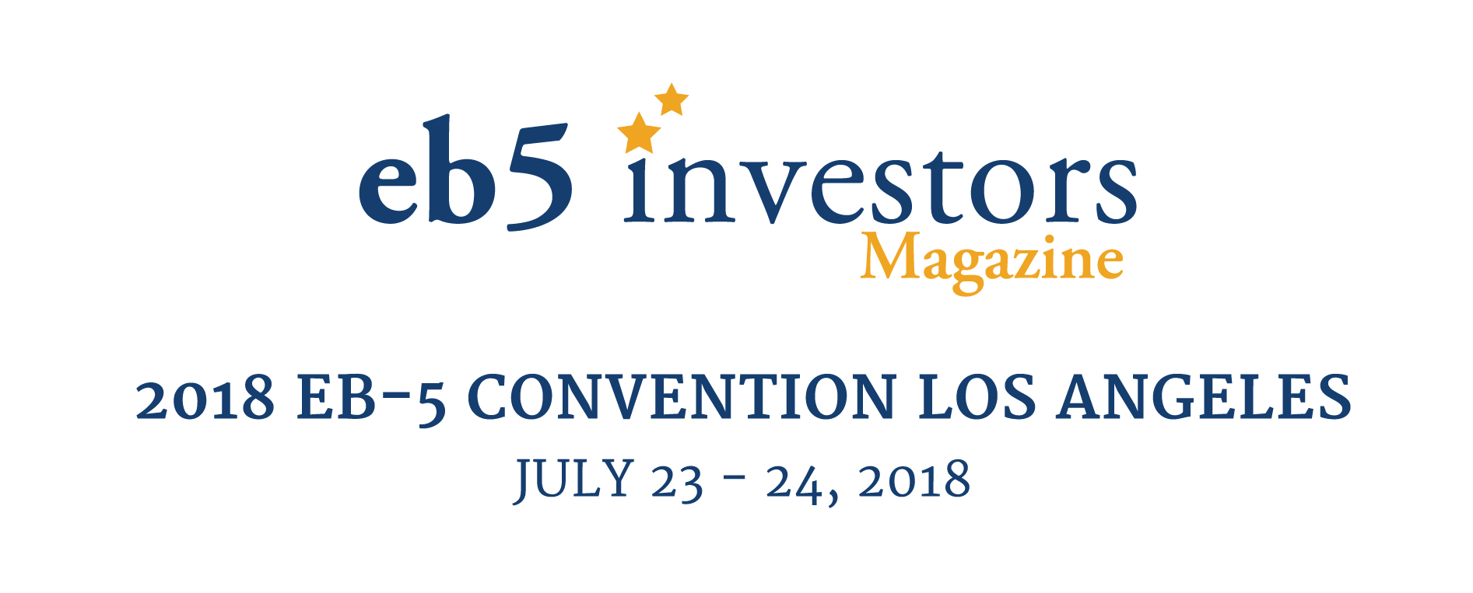
One Franchise, Many Options: How immigration types E-2, L-1, EB-1C fit into business
Panel Topic
Speaker Names / Companies:
Adrian Pomery / One Lily Pad
William Dean / Masterplans.com
Jay Rosen / Saul, Ewing Arnstein & Lehr, LLP
Mona Shah / Mona Shah & Associated Global
Moderated By:
David Hirson, David Hirson & Partners, LLP

Slide 3
Round 1
Mr. Pomery: How do you convert your EB-5 operations to L-1/E2 or vis versa?
Mr. Dean: What should your business plan include to get an E-2, L-1, or EB-5 visa approved and what are the differences between these various visas’ business plans?
Mr. Rosen: When creating or purchasing an E-2 business, what are the first and most important corporate aspects one should consider?
Ms. Shah: What are the similarities and differences between an EB-5 investment structure and an E-2, L-1, or EB-1C structure?

Slide 4
Round 2
Mr. Pomery: What are some of the potential obstacles for franchising and L-1/E2?
Mr. Dean: Why are business plans important for E-2, L-1, and EB-1C? Why are they strongly recommended when not required by regulations?
Mr. Rosen: What particular considerations should be taken into account when structuring and negotiating a franchise concept E-2 business?
Ms. Shah: What are the minimum investment amounts you have seen that are approved and what are the investment amounts that are denied?

Slide 5
Round 3
Mr. Pomery: Can you scale L-1 opportunities to suit the needs of Chinese migration agents?
Mr. Dean: Which type of franchise works best for getting an investor visa?

Slide 6
Q & A

Slide 7
DISCLAIMER
This presentation outline and the presentation itself are for general education purposes only and are not intended to provide specific guidance or legal advice about what to do or not to do in any particular case. You should not rely on this general information to make decisions about specific immigration matters. If you are not yourself a lawyer, you should seek the assistance of an immigration lawyer to help you resolve these issues. Thank you.

