Slide 2
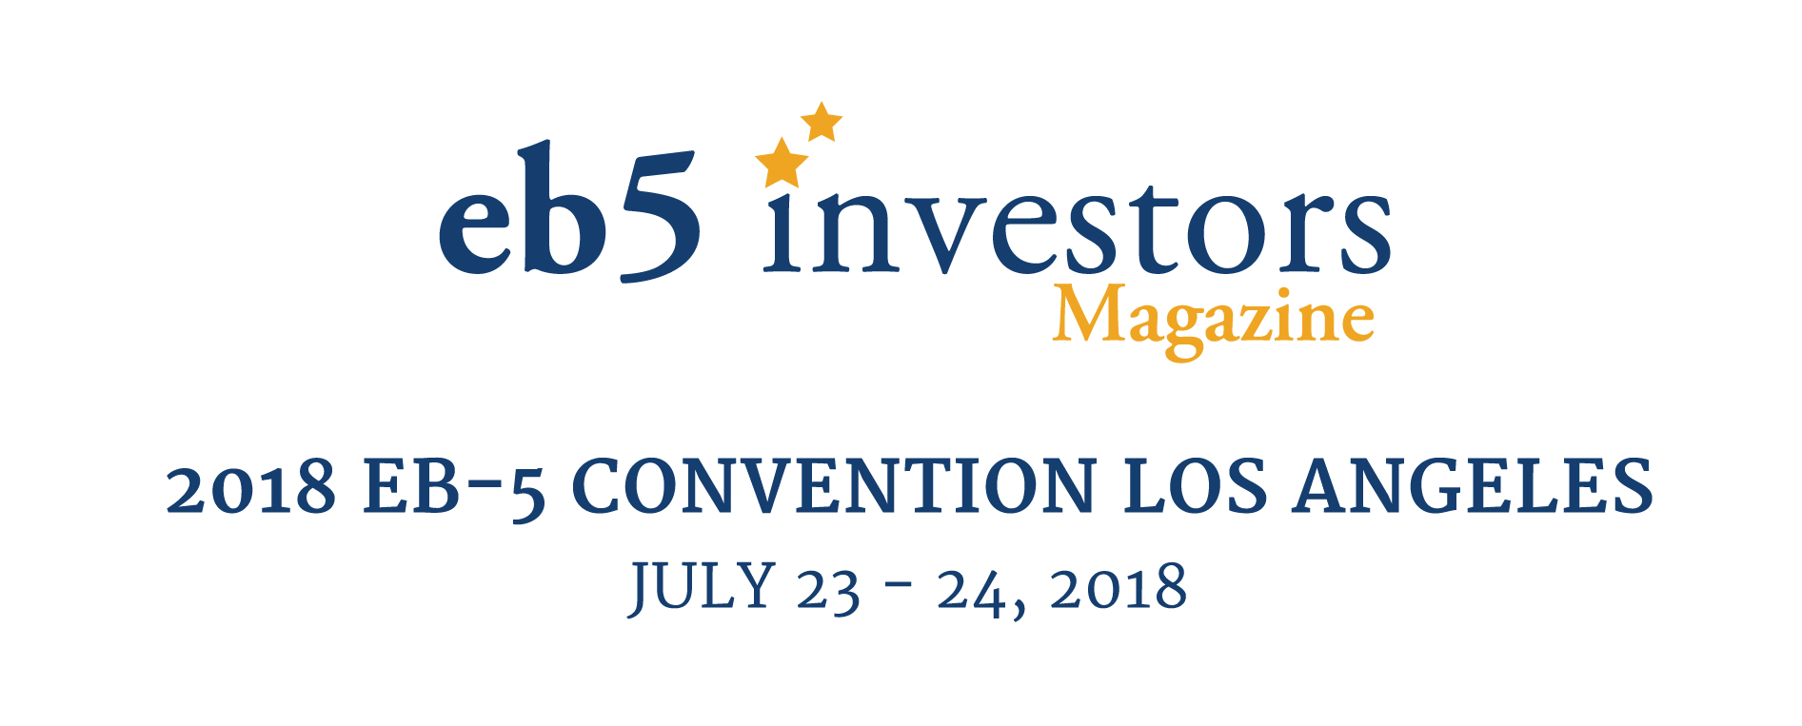
A Deep Dive Into "At Risk“
Michael Homeier, Homeier Law PC
Mary King, New York City Regional Center (NYCRC)
Raymond Lahoud, Norris McLaughlin & Marcus
Mitch Wexler, Fragomen Worldwide
Moderated by:
Carolyn Lee, Miller Mayer, LLP
:

Slide 3
What does “at risk” mean?
Where does the “at risk” requirement come from?
Why is the “at risk” requirement so sticky?
Notes:
Carolyn – set the stage

Slide 4
Redeployment
Redemption
Guarantees
Notes:
Topics to cover

Slide 5
Redeployment
What is it
Why is it required
Risks
Managing risks
Notes:
Open discussion

Slide 6
Redemption
What is prohibited redemption
Characteristics
Recent denials & litigation – call/buy options
Managing risks
Notes:
Open discussion

Slide 7
Guarantees
What is prohibited guarantee
RFEs
Managing risks
Notes:
Open discussion

Slide 8
Questions?
Notes:
Open discussion

Slide 9
DISCLAIMER
This presentation outline and the presentation itself are for general education purposes only and are not intended to provide specific guidance or legal advice about what to do or not to do in any particular case. You should not rely on this general information to make decisions about specific immigration matters. If you are not yourself a lawyer, you should seek the assistance of an immigration lawyer to help you resolve these issues. Thank you.

