Slide 1



Slide 2


The Right Fit
How Current and Future EB-5 Projects are
Changing with the Market
Speaker Names / Companies:
Suzanne Lazicki – Lucid Professional Writing
Eric Orenstein – Rosenberg & Estis, P.C.
Sam Silverman – EB5 Affiliate Network
Jor Law – Homeier Law PC
Moderated By:
Phil Cohen – Strategic Element, Inc.

Slide 3



Panelist Introductions
Marketing: Current Market and How to Compete
Changes in Project Structure
Project Review
Workouts, the Secondary Market and Blockchain
The Impact of Program Changes on Future Projects

Slide 4
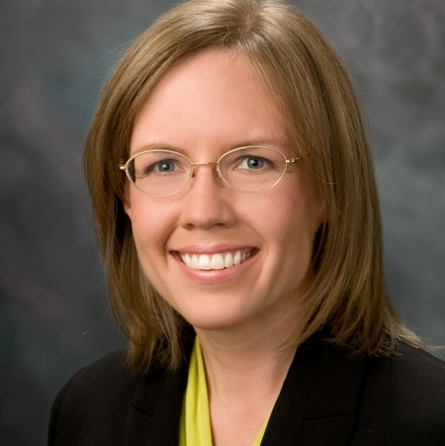
Lucid Professional Writing specializes in business plans for immigrant and non-immigrant investment
Since 2010
Author of business plans for over 150 EB-5 regional center projects and 90 direct EB-5 projects
Industry thought leader
Provides EB-5 news and analysis at https://blog.lucidtext.com/
MBA
Top 5 service provider: EB-5 Investors Magazine, 2017 and 2018
Suzanne Lazicki
President
Lucid Professional Writing
E-mail Me
Suzanne@lucidtext.com
Call Me
(626) 660-4030

Slide 5
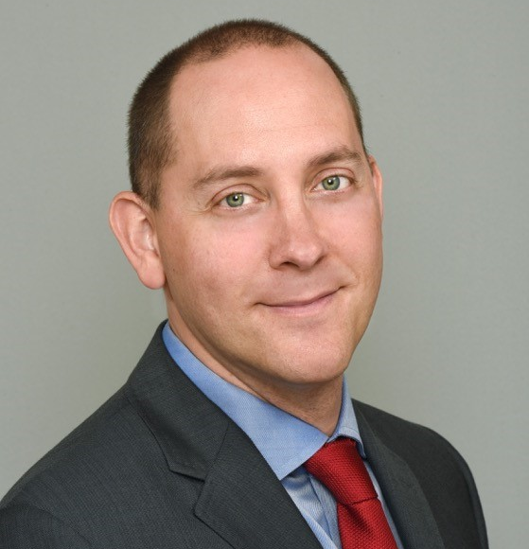
Rosenberg & Estis P.C. is known for tenacious and successful representation in all aspects of commercial real estate. For 40+ years, the firm’s sole concentration has been real estate, giving its 80+ attorneys a vast breadth of knowledge and expertise in one of the most expensive and competitive markets in the country. Eric joined the firm in 2005.
Eric’s notable work:
  Lead counsel representing the EB-5 lender in a $279 million construction mezzanine loan for a mixed use (retail/hotel/residential condominium) project located in Chelsea, New York.
  Lead counsel representing the EB-5 lender in a $249 million construction mezzanine loan for a redevelopment in downtown Brooklyn, New York.
  Lead counsel representing the EB-5 lender in a $200 million construction mezzanine loan for a mixed-use (retail/hotel) project in the Times Square district in New York.
  Lead counsel representing the EB-5 lender in a $96 million construction mezzanine loan for a mixed-use (retail/hotel) project in Boca Raton, Florida.
  Lead counsel representing an EB-5 preferred equity investor in a $75 million investment in a mixed use (hotel/retail/condominium) project in West Hollywood, California.
  Lead acquisition, development and finance counsel to developer in a $69 million senior construction and mezzanine loan in connection with a mixed use condominium development located on Wooster Street, New York
Eric S. Orenstein
Member,
Rosenberg & Estis, P.C.
E-mail Me
eorenstein@rosenbergestis.com
Call Me
(212) 551-8438

Slide 6

EB5 Affiliate Network (EB5AN) is a national EB-5 regional center operator, consulting firm and asset manager with 15 approved regional centers covering 27 full states; 300+ EB-5 project transactions since 2013 with 100% USCIS approval
EB5AN supports EB-5 project developers and investors by providing a turnkey EB-5 project documentation solution and immediate regional center sponsorship to qualified projects
Previously served as the Director of Corporate Strategy and Expansion for Golfer Jack Nicklaus
Previously employed by the Boston Consulting Group (BCG), one of the top management consulting firms
Forbes Magazine 30 Under 30 National Winner
B.A. in Economics from Yale University
M.B.A. in from Stanford University
Sam Silverman
Managing Partner,
EB5 Affiliate Network
E-mail Me
Sam.Silverman@EB5AN.com
Call Me
(800) 288-9138

Slide 7

Co-founder of Homeier Law PC
Co-founder of VerifyInvestor.com, the dominant accredited investor verification service in the world
Created EB-5 practice at Homeier Law PC which has been recognized as an industry leader with experience representing well over 500 different EB-5 matters
Influencer in crowdfunding industry
Pioneer in building out the ecosystem for digitizing and trading securities on the blockchain and other distributer ledger technologies
Expert on attracting and verifying accredited investors
Jor Law
Corporate/Securities Attorney
E-mail Me
Jor@homeierlaw.com
Call Me
(818) 450-1550

Slide 8
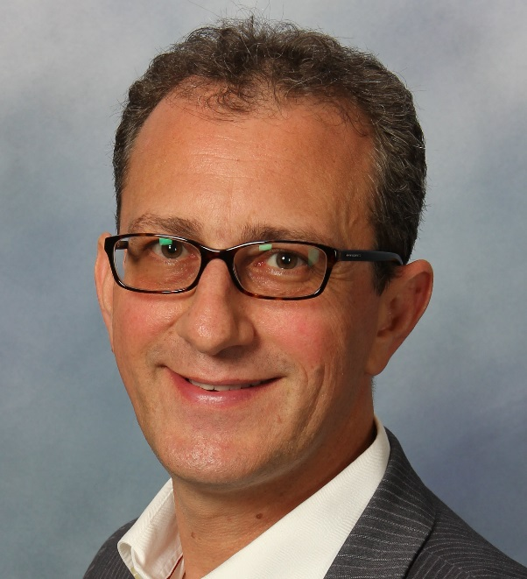
Provider of business plans, feasibility studies and economic reports
Since 2010
Involved in projects raising over $3 billion in EB-5 capital
Author of The EB-5 Definitive Guide
Regular blogger and speaker at industry events
Top 5 service provider: EB-5 Investors Magazine, 2017 and 2018
NES Medallion Partner
Phil Cohen
President
Strategic Element Inc.
E-mail Me
Pcohen@StrategicElementConsulting.com
Call Me
(888) 834-5565

Slide 9

Panelist Introductions
Marketing: Current Market and How to Compete
Changes in Project Structure
Project Review
Workouts, the Secondary Market and Blockchain
The Impact of Program Changes on Future Projects

Slide 10
Pending I-526 Petitions Continue to Increase, but New Application Receipts Have Stabilized
I-526 Petition Processing by Year
Denials
Approval
Receipts
Pending
Number of I-526 Petitions
922
1,056
1,735
5,018
1,266
957
943
3,347
1,571
FY2011
FY2012
FY2013
FY2014
FY2015
FY2016
FY2017

Slide 11
High Variance of New I-526 Application Receipts by Quarter due to Extension Deadlines
I-526 Petition Processing by Quarter
Denials
Approval
Receipts
Number of I-526 Petitions
236
257
293
199
217
278
273
433
1,637
1,513
1,731
1,864
2015 Q2.
Jan-Mar 2015
2015 Q3.
Apr-Jun 2015
2015 Q4.
Jul-Sep 2015
2016 Q1.
Oct-Dec 2015
2016 Q2.
Jan-Mar 2016
2016 Q3.
Apr-Jun 2016
2016 Q4.
Jul-Sep 2016
2017 Q1.
Oct-Dec 2016
2017 Q2.
Jan-Mar 2017
2017 Q3.
Apr-Jun 2017
2017 Q4.
Jul-Sep 2017

Slide 12
As of July 2017, 17% of EB-5 Investors Obtained EB-5 Visas via Adjustment of Status in FY17
EB-5 Visa Usage (State Dept. VS USCIS)
EB-5 Visa Usage Consular Processing (State Dept.) versus Adjustment of Status (USCIS) – FY 2008-FY2017 (July)
USCIS
State Dept.
FY 2008
FY 2009
FY 2010
FY 2011
FY 2012
FY 2013
FY 2014
FY 2015
FY 2016
FY 2017¹
1 Through July 2017. Preliminary results provided by U.S. Department of States. Final statistics are subject to change
Data Source: U.S. Department of State, IIUSA

Slide 13
Shifting Market Trends
2015
2016
2017
2018
Average EB-5
Project Raise
~$50M
~$10M
Market Share of Largest Players
~60%
~40%
Market Share of Smaller Players
~40%
NOW
~60%
% of Chinese Investors
~80%
~40%
Rest of World Investors
~20%
~60%

Slide 14

How to Differentiate Your EB-5 Project
Construction
Compensation
Guarantees
Exemplar
Support
Return
Project needs to address key investor concerns to successfully complete fundraising
Wide range of EB-5 projects seeking Investor Capital

Slide 15


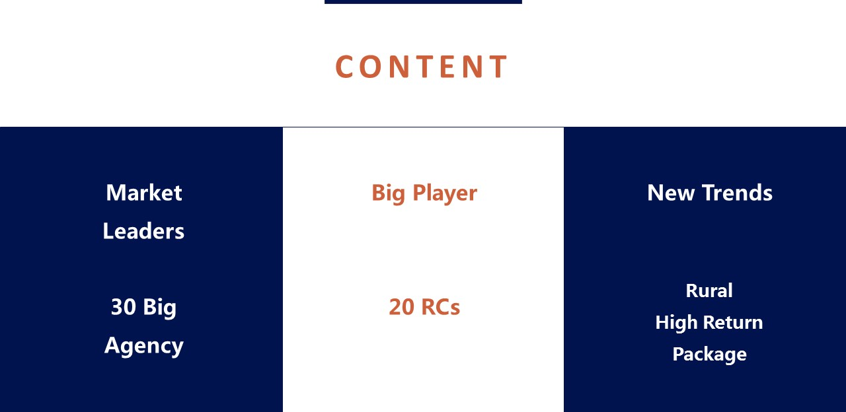

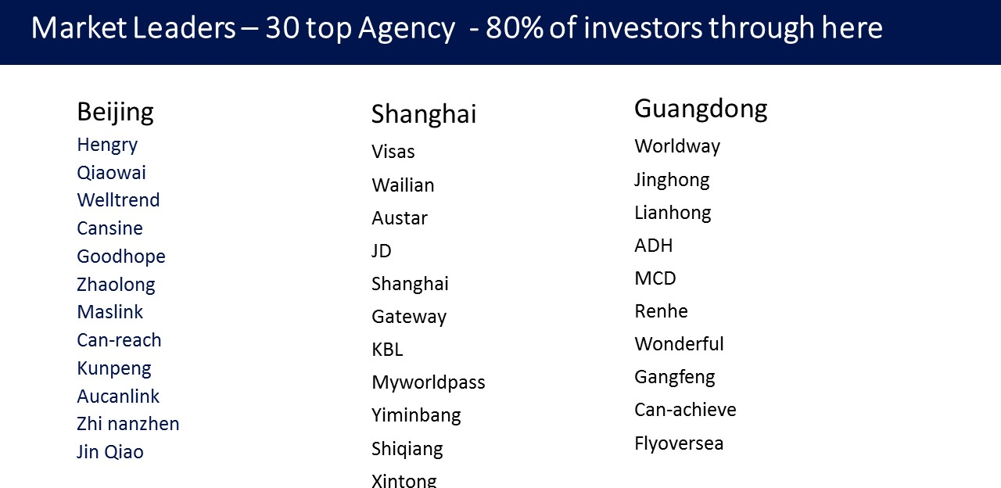
A Few Current Market Trends
Higher investor returns (2-4%) (retrogression)
Smaller, under development projects
(branded hotels / multi-family, $5-25M)
Vertical integration of
regional center / developer / broker

Slide 16








Investor Sourcing Channels
TRADITIONAL
NON-TRADITIONAL
Other channel partners, U.S. based investors, direct to investor promotion at overseas roadshows and educational consulting events
Migration Agents in China, Brazil, India, Vietnam, LATAM

Slide 17
How Smaller Projects Win
Admin
Fee
Guerilla
Marketing
Profit
Sharing
Successful
EB-5 Project
Marketing
Personal
Network
Marketing
Financial
Safety
I-526
Approval
Guarantee

Slide 18

Panelist Introductions
Marketing: Current Market and How to Compete
Changes in Project Structure
Project Review
Workouts, the Secondary Market and Blockchain
The Impact of Program Changes on Future Projects

Slide 19

Project Trends
Smaller deals
Higher returns
Less migration agents
Closer networks
Fragmentation

Slide 20

Structure
Operational company structure vs. fund structures
Redeployment provisions
What to do if not contemplated?

Slide 21
Panelist Introductions
Marketing: Current Market and How to Compete
Changes in Project Structure
Project Review
Workouts, the Secondary Market and Blockchain
The Impact of Program Changes on Future Projects

Slide 22

‘Credibility’ is in the Details…
Googling adjudicators/ public information:
  Earth: Construction
  Validating claims generally
Small project
Inexperienced developer/ business operator
Confirming non-EB-5 funding
Permits in place: USCIS validation
Validation of construction budget & timeline
Pay rate validation
Extraneous information vs. helpful detail
Validation of pro forma

Slide 23

Market Analysis/ Feasibility: Proving Projections
Appearing more frequently
Full study: not required, but good idea
Demand: the missing link
What’s enough?
When to get a full study
Judgment call: avoid after-the-fact

Slide 24

A Few Reminders…
Beware of the kitchen sink
Conclusive assumptions
Legality
Consistency of numbers

Slide 25

Panelist Introductions
Marketing: Current Market and How to Compete
Changes in Project Structure
Project Review
Workouts, the Secondary Market and Blockchain
The Impact of Program Changes on Future Projects

Slide 26

When things go wrong
Forbearances and workouts
Exercising remedies (or not)
Risks for new workout parties

Slide 27

Secondary Market
Transfer restrictions
Lack of liquidity
Private resales

Slide 28

Blockchain
What is it?
Source of funds
Building trust
Secondary markets

Slide 29
Panelist Introductions
Marketing: Current Market and How to Compete
Changes in Project Structure
Project Review
Workouts, the Secondary Market and Blockchain
The Impact of Program Changes on Future Projects

Slide 30
Potential program changes that may shape future EB-5 projects
Possible changes | EB-5 Modernization Regulation | Possible Legislation | RC Program Regulations
Minimum EB-5 investment amount | X | X
TEA definitions and incentives | X | X
Priority date protections | X | X
RC program authorization |  | X
EB-5 visa availability |  | X
Fees and requirements |  | X | X
Adjudication process |  | X | X
Time Estimate | 2018? | ? | 2019?
Other Systemic Change Drivers
Education about visa availability and wait times
Changes to processing times
Alternatives to EB-5

Slide 31
Minimum EB-5 Investment Amounts

Slide 32
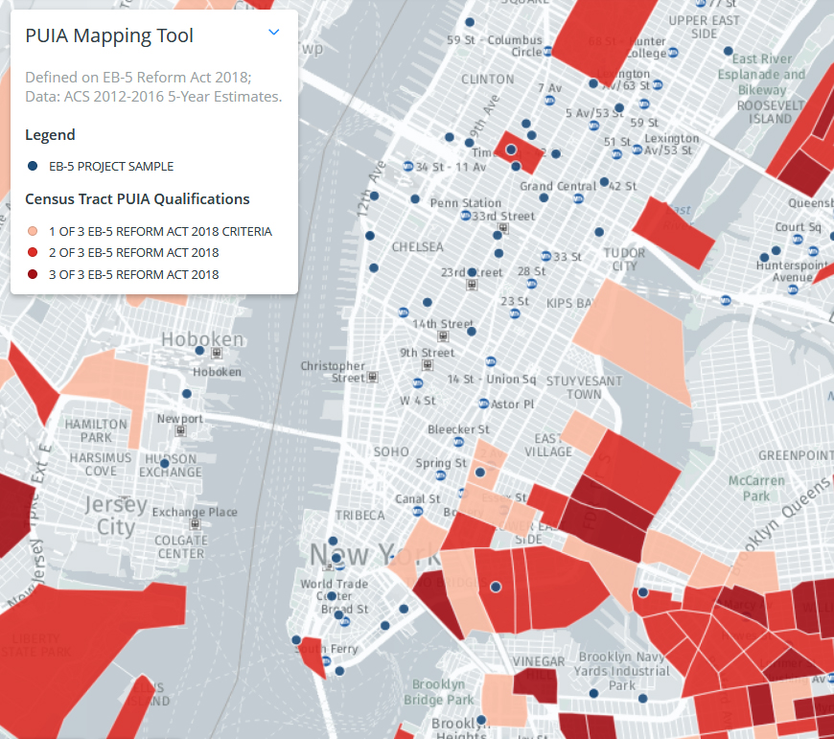
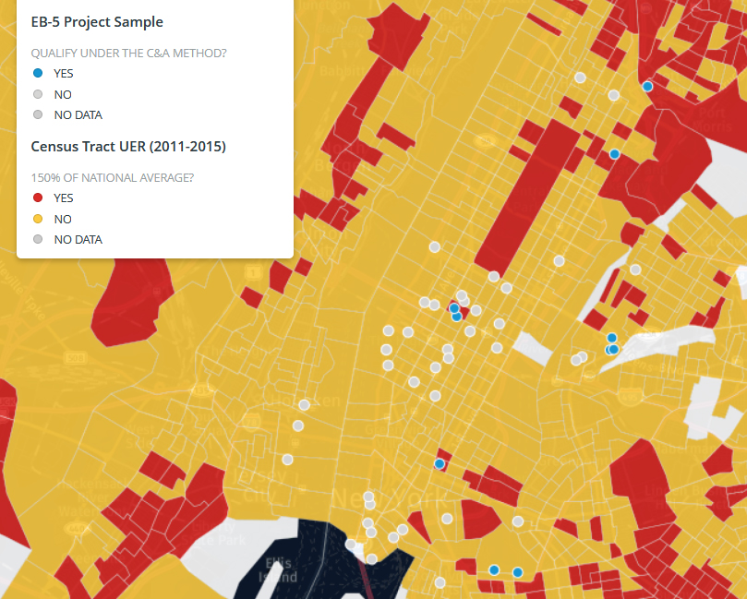
Targeted Employment Area Definitions
Legislation
Regulations
Other
Rural
Infrastructure
Territories
BRAC
Incentives
Investment amount
Visa set aside
Expedite
Map Source: https://iiusa.org/

Slide 33
I-526 Receipts
Annual EB-5 Visa Supply
≈3 visas/investor
≈10,000 EB-5 visas (≈3,333 investors)
≈700 visas/country (≈233 investors)
Backlog as of Q4 2017
≈30,000 pending visa applications
≈25,000 pending I-526
Countries over/near limit: China, Vietnam, India, Brazil, Taiwan, South Korea
Possible Changes
(+) Quota per investor, more visas
(-) Per-country limit, set-asides
Actual number of I-526 petitions filed
Sustainable number of I-526 receipts assuming annual visa quota of 10,000 and average 3 visa applications per petition

Slide 34
Potential Future Program Impacts
Potential Future Project Impacts
Fewer prospective investors
Limit on high-volume countries
Stronger TEA incentives
Fewer jobs required per EB-5 dollar
More flexibility to change projects
Cost of EB-5 capital
Fewer regional centers & offerings
Faster & more predictable processing
Megaprojects (-)
Small business (-)
Projects outside Tier 1 cities (+/-)
Direct EB-5 (+/-)
Franchises (+/-)
Redeployment projects (+)
Non-real estate projects (+)
Projects that depend on EB-5 (+)

Slide 35

Questions?

Slide 36
DISCLAIMER
This presentation outline and the presentation itself are for general education purposes only and are not intended to provide specific guidance or legal advice about what to do or not to do in any particular case. You should not rely on this general information to make decisions about specific immigration matters. If you are not yourself a lawyer, you should seek the assistance of an immigration lawyer to help you resolve these issues.
Thank you.

