Slide 1
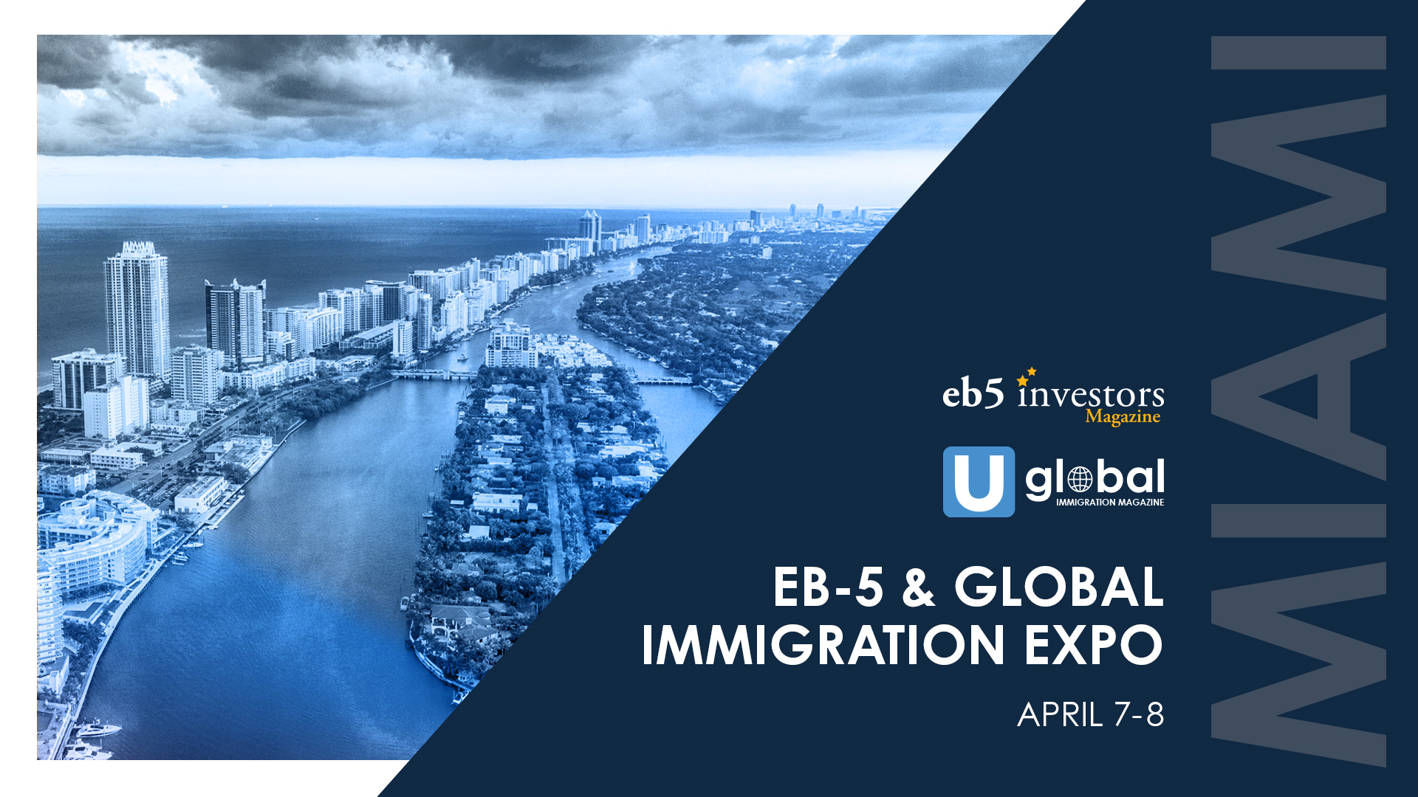

Slide 2
EB-5 emerging markets: Strategies to legally prove source and path of funds for EB-5 Investments in new hotspots and on a global scale; and best due diligence practices
Speakers
John Pratt, Kurzban Kurzban Weinger and Tetzeli, PA
Rebecca E. Singh, Mona Shah & Associates Global
Michael Homeier, Law Office of Michael G. Homeier PC
Rafael Lamberti, Reinhardt LLP
Moderated by:
Nicolai Hinrichsen, Miller Mayer

Slide 3
Overview of source and path of funds, and changes under new EB-5 law Legal challenges to EB-5 SOF
Focus on emerging markets
Brazil/South America
Africa
South East Asia
Vietnam
Indonesia, Thailand, Singapore, Philippines,
Europe
Q and A

Slide 4
DISCLAIMER​
​
This presentation outline and the presentation itself are for general education purposes only and are not intended to provide specific guidance or legal advice about what to do or not to do in any particular case. You should not rely on this general information to make decisions about specific immigration matters. If you are not yourself a lawyer, you should seek the assistance of an immigration lawyer to help you resolve these issues. Thank you.​
​

