Slide 1
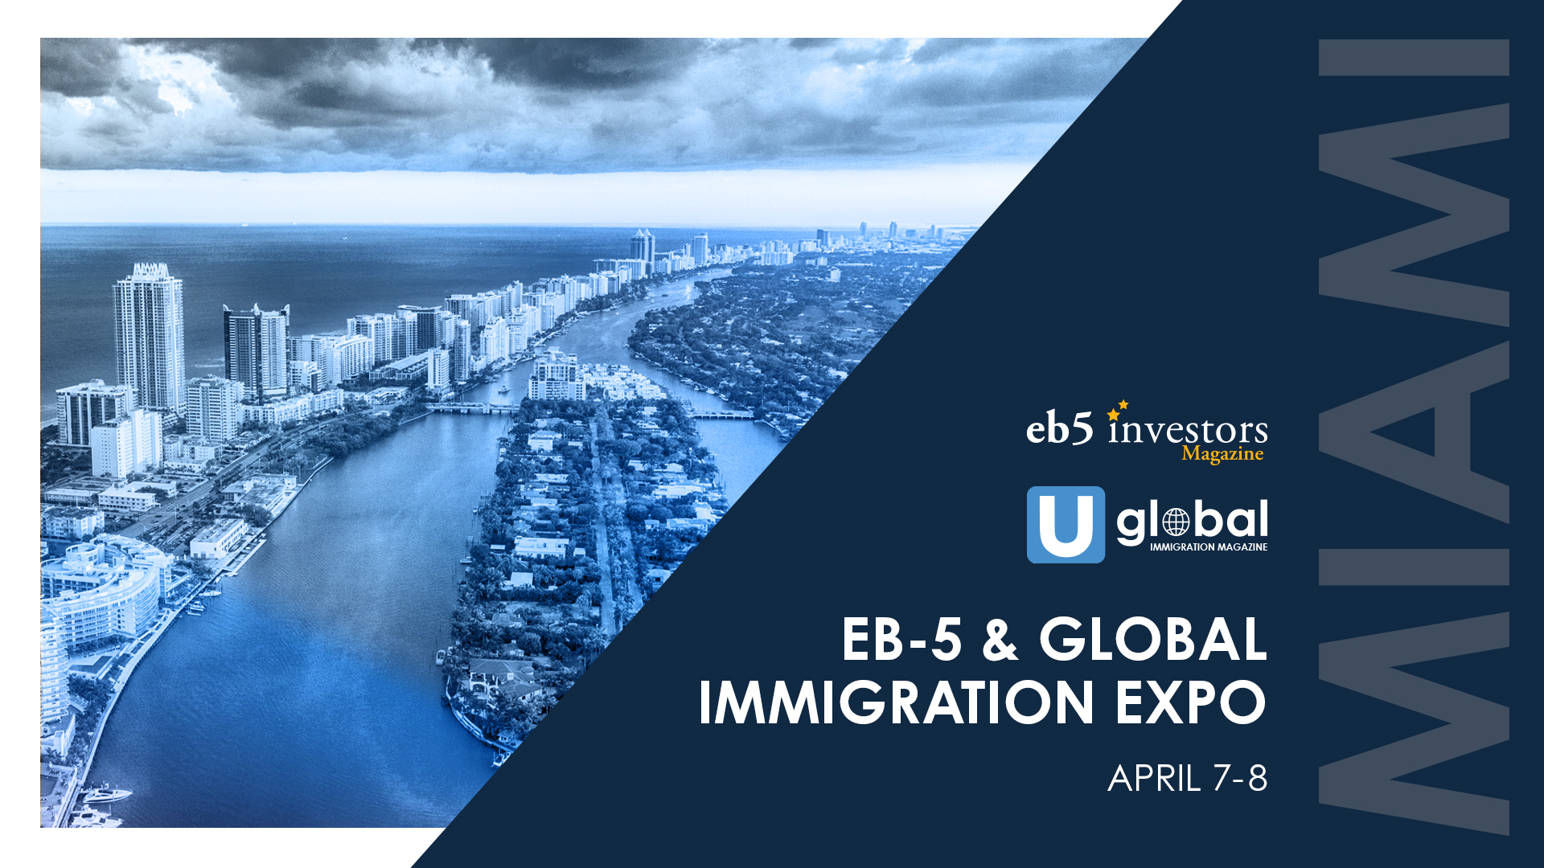

Slide 2
The American Dream Route
Why EB-5 is still one of the best green card options to America and how to use the E-2 bridge and other alternative visa options for faster results
Katya Stelmakh, Stelmakh & Associates
Natalia Polukhtin, Global Practice Group
Phuong Le, KLD LLP
Marko Issever, America EB5 Visa
Moderated By:
Christian Triantaphyllis, Jackson Walker

Slide 3
What does your client REALLY want?
Managing client’s expectations regarding the “American Dream”: is EB-5 the right choice for your client?
• Processing time
• Tax compliance
• Transparency in Source of Funds (are you able and willing to disclose?)
• Cost of getting his green cards
• Actual involvement with business operations
Less obvious benefits of EB-5
• Asset protection through integrity measures of the new legislature
• Concurrent filing, significant beneficiaries, students with F-1, workers
with H-1B, etc.
• Passive investment without immediate involvement
• Access to credit, banking, business resources of the leading economy

Slide 4
What do I do in the US while my EB-5 petition is pending?
Non-immigrant visa options for bridging
• F-1
• H-1B (pay attention to timing)
• L-1A
• O-1
• E-1/E-2
Strategizing for bridging E2 to EB-5
• Must have treaty (possibly get an appropriate passport)
• Continuing extensions of E-2
• Be mindful of express immigrant intent
• Different burden of proof for SoF for E-2 and EB-5
• Two different strategies: E-2 and EB-5 may be the same or different enterprises
• Possible issues with reinvesting the funds of the same enterprise
Hypothetical: Non-treaty investor -> Passport of the treaty country -> E-2 -> EB-5

Slide 5
DISCLAIMER​
​
This presentation outline and the presentation itself are for general education purposes only and are not intended to provide specific guidance or legal advice about what to do or not to do in any particular case. You should not rely on this general information to make decisions about specific immigration matters. If you are not yourself a lawyer, you should seek the assistance of an immigration lawyer to help you resolve these issues. Thank you.​
​

